Slide 1
ON-PAPER DESIGN
Group-7
Batch Weighing Machine
MuP - 2020-21

Slide 2
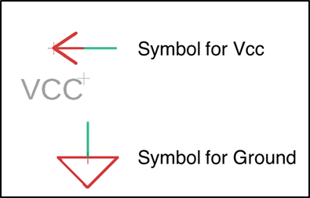
In some places, Vcc and GND are not available on the chip. They have been shown separately near the chip
All the Vcc’s mentioned in the on paper design are 5V unless labelled explicitly giving a different voltage

Slide 3
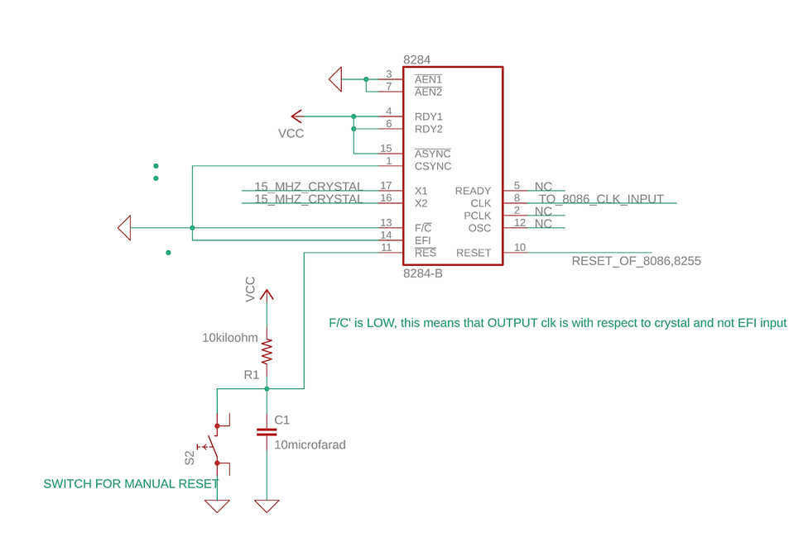
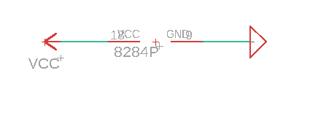
8284 - Clock Generator

Slide 4
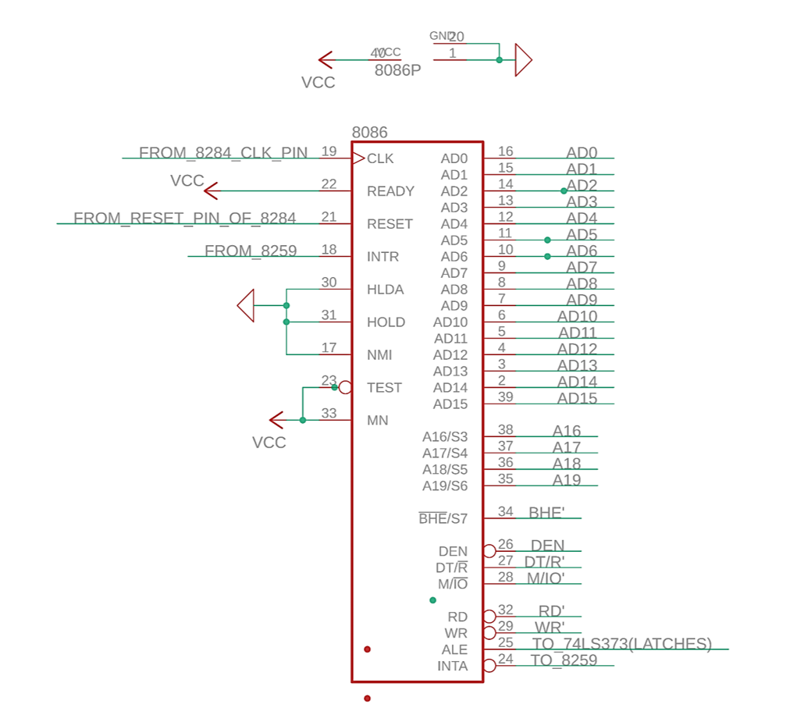
8086

Slide 5
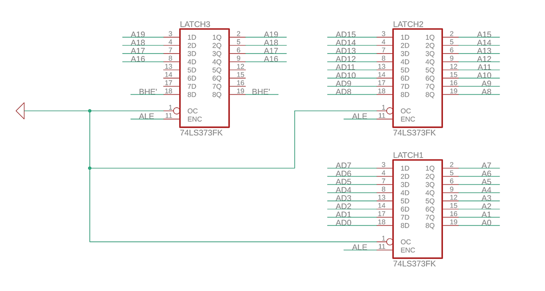
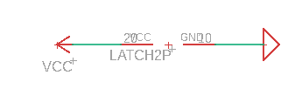
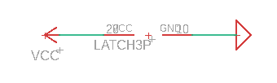
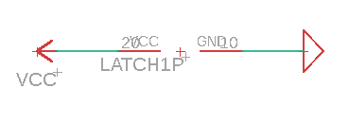
74LS373 Latch

Slide 6
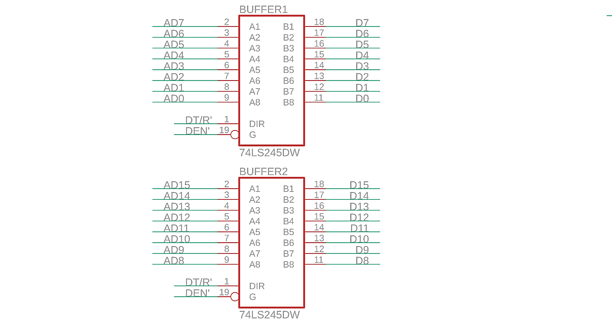
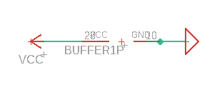
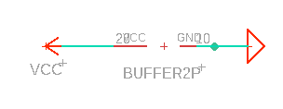
Data Bus Buffers

Slide 7
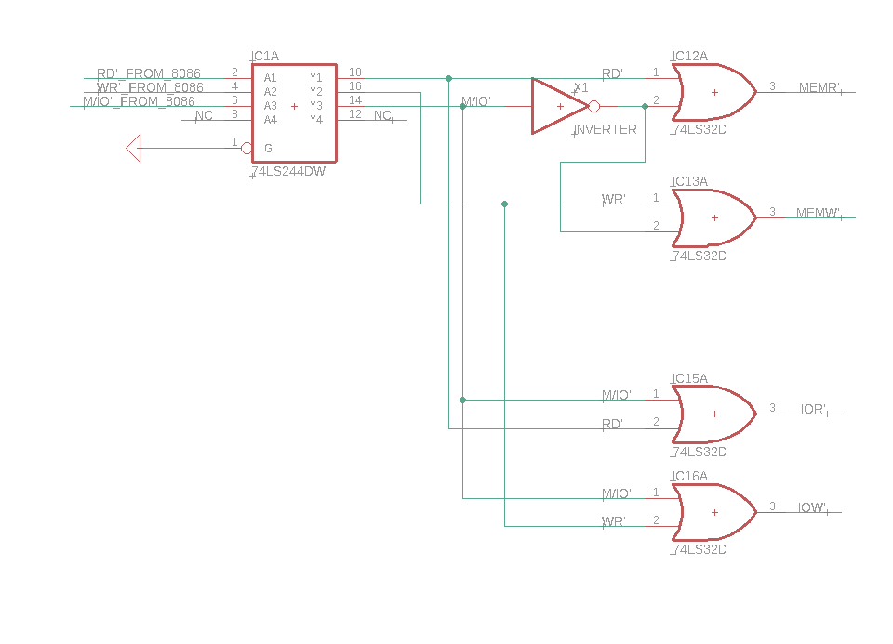
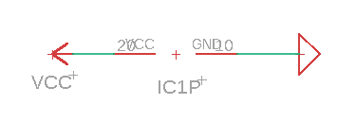
Control
Signals
Buffer
Control Signals

Slide 8
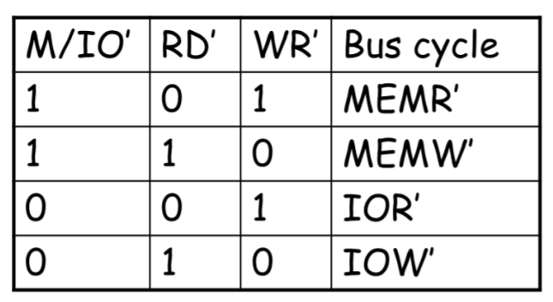
Logic for the formation of control signals

Slide 9
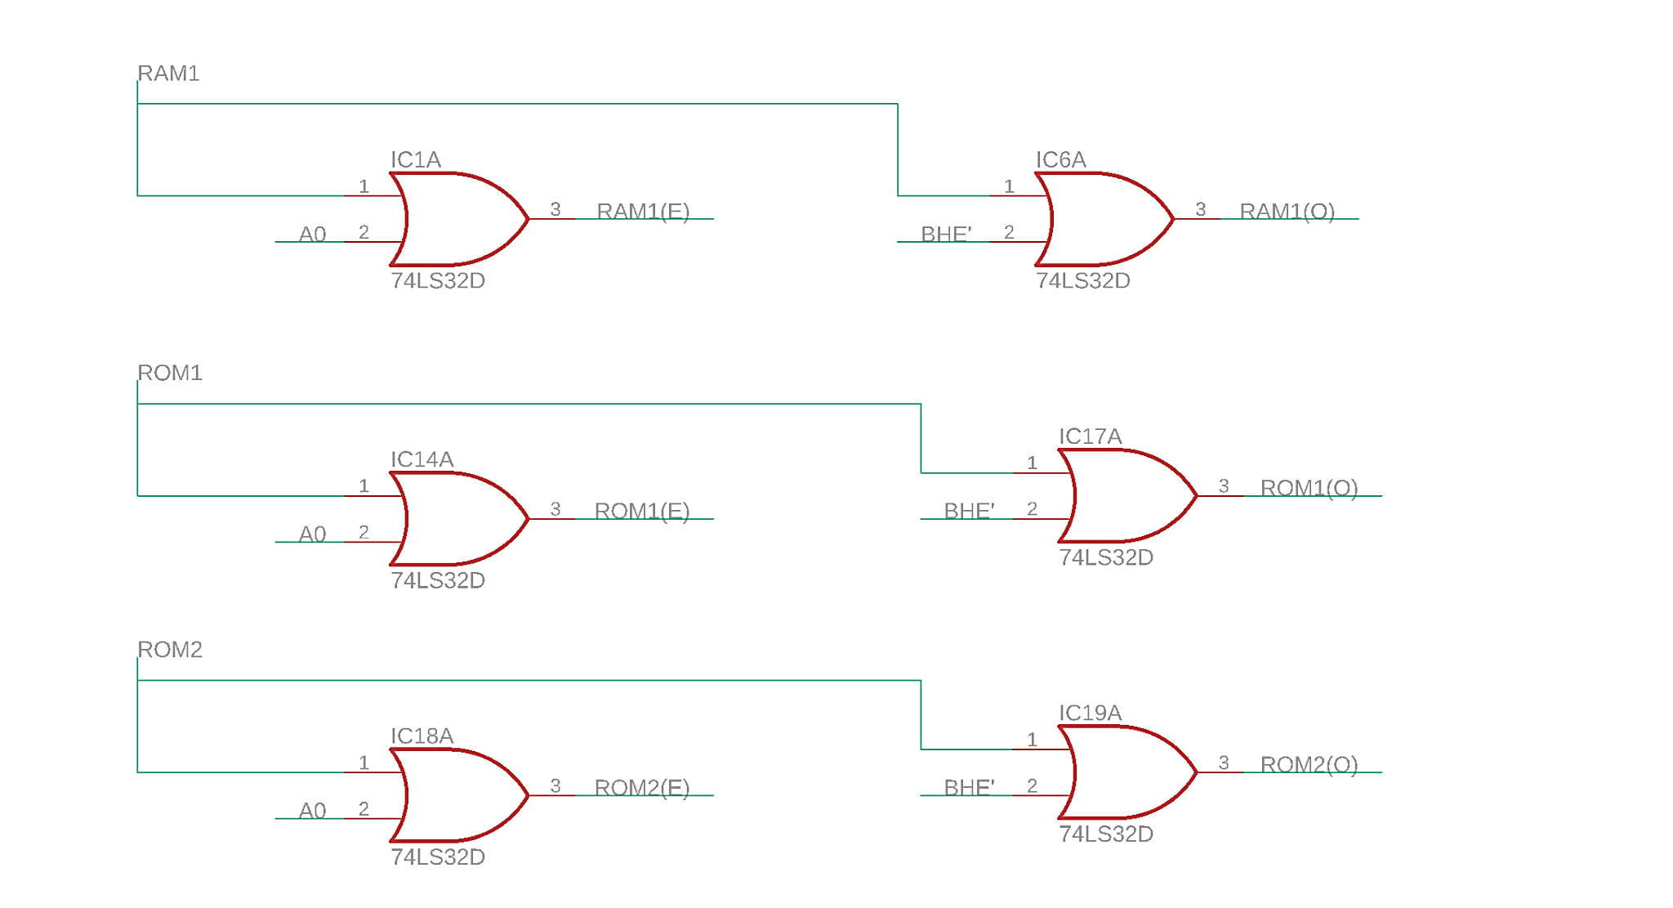
Chip Select for even, odd banks
RAM_FROM MEMORY DECODER
ROM_1_FROM MEMORY DECODER
ROM_2_FROM MEMORY DECODER

Slide 10
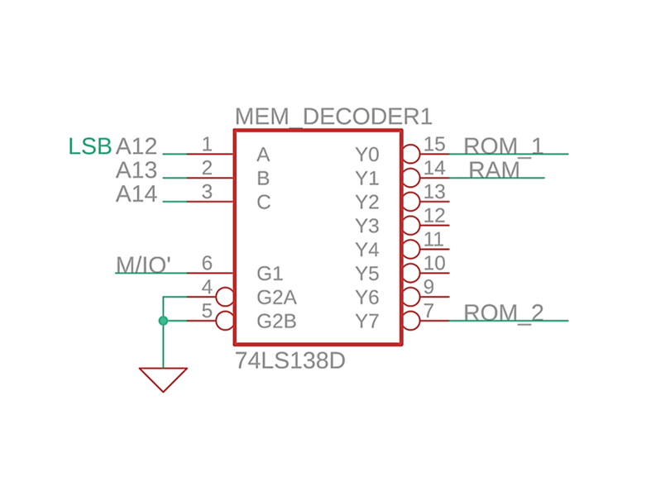
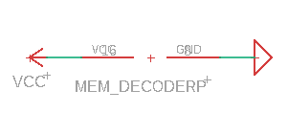
74LS138 - Memory Decoder

Slide 11
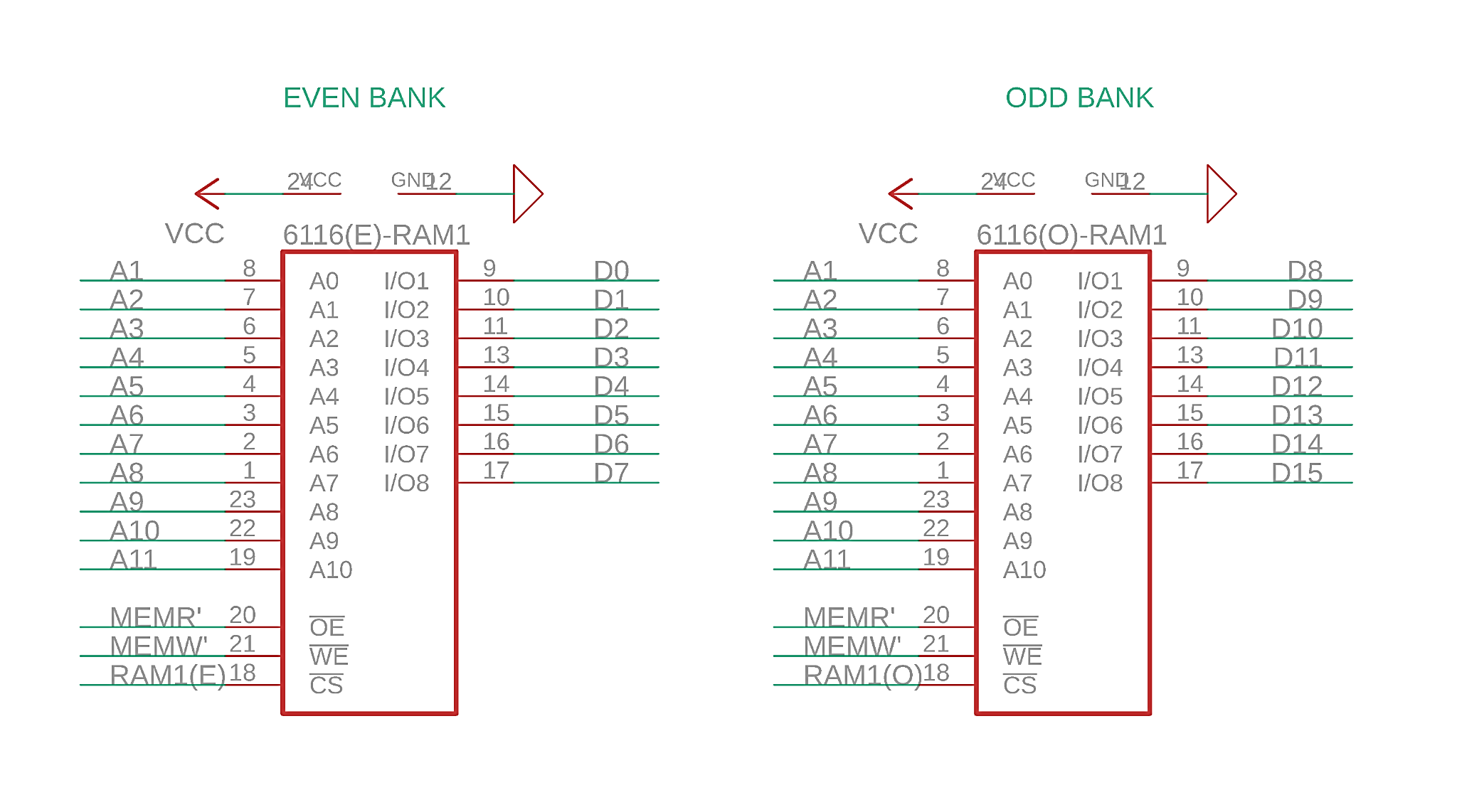
6116-
2K RAM

Slide 12
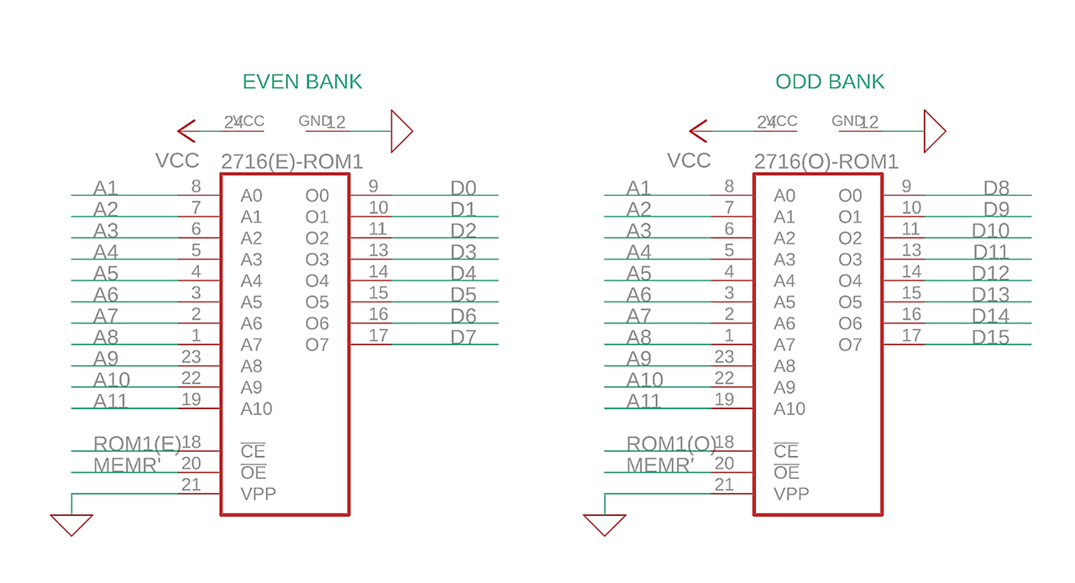
2716-
2K ROM1

Slide 13
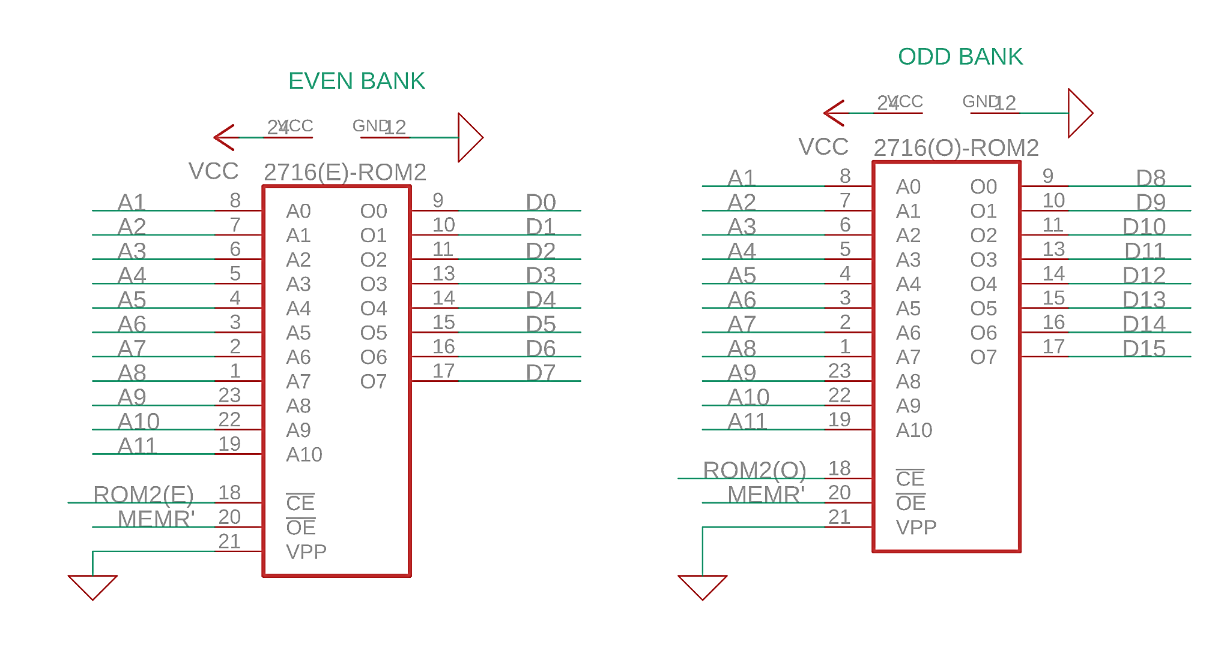
2716-
2K ROM2

Slide 14
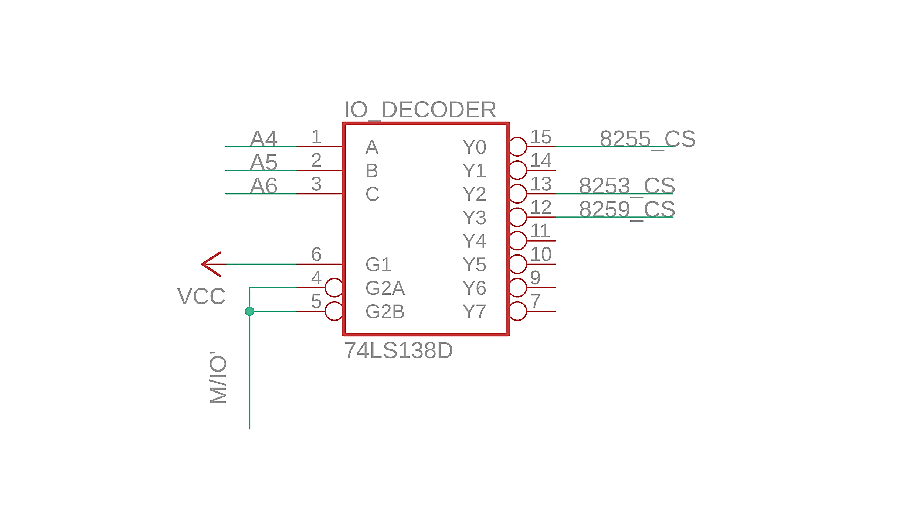
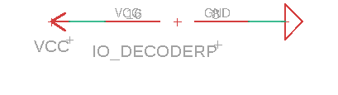
74LS138 - IO Decoder

Slide 15
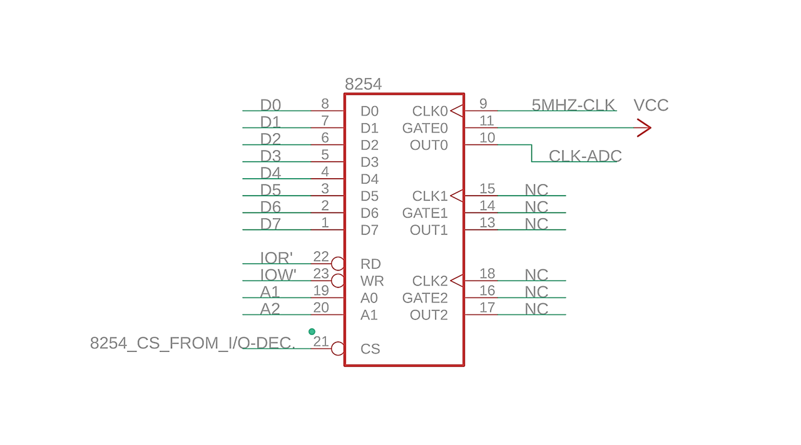

8254 - Programmable Interval Timer

Slide 16
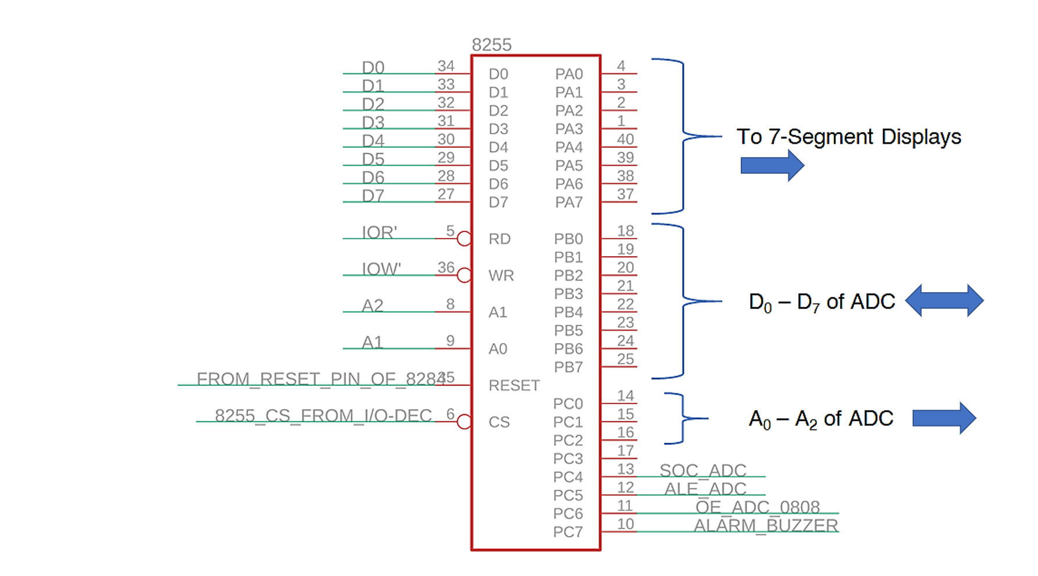
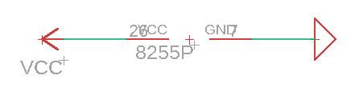
8255 - Programmable Peripheral Interface

Slide 17
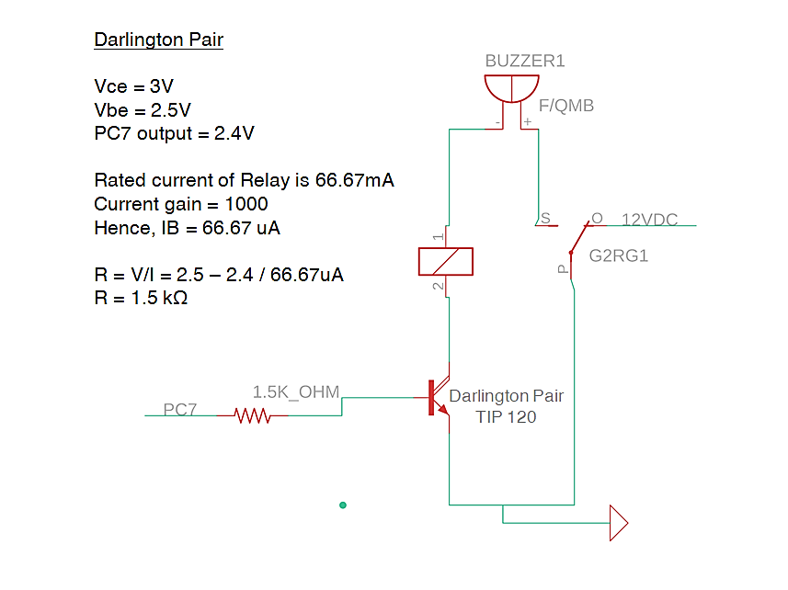
Relay for Alarm

Slide 18
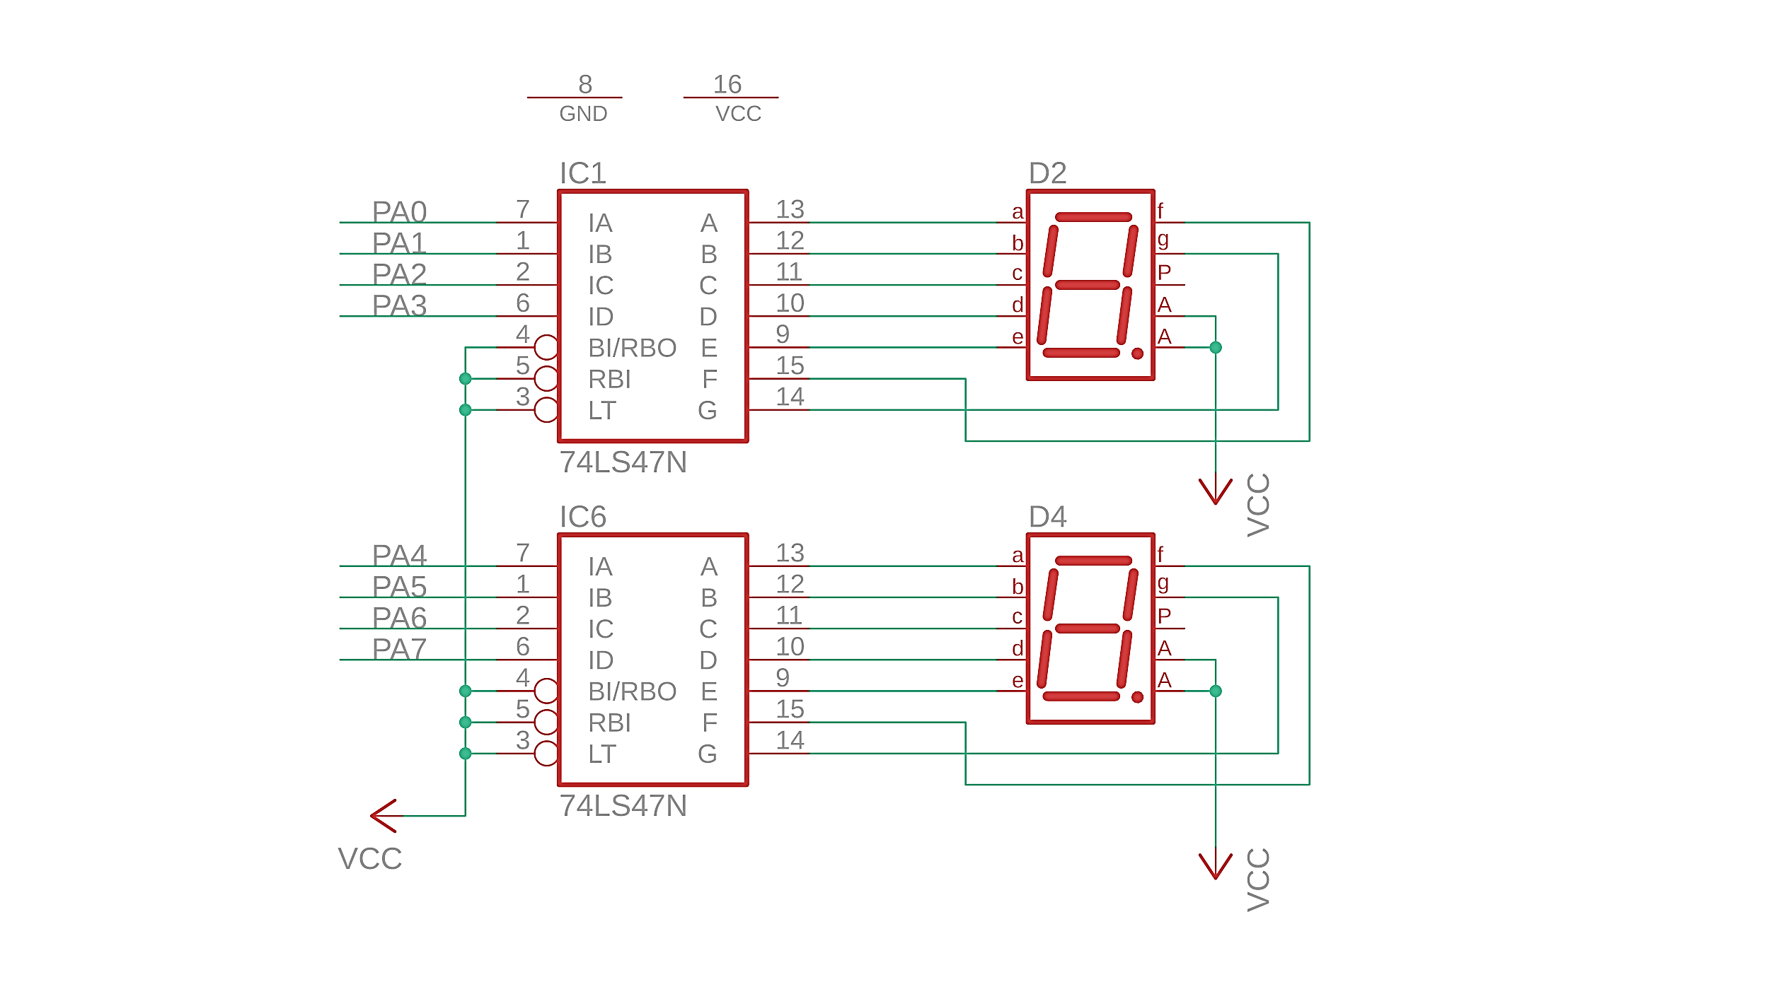

74LS47N &
7-segment displays (common anode)
IC1G$2
Units Place
10s Place

Slide 19
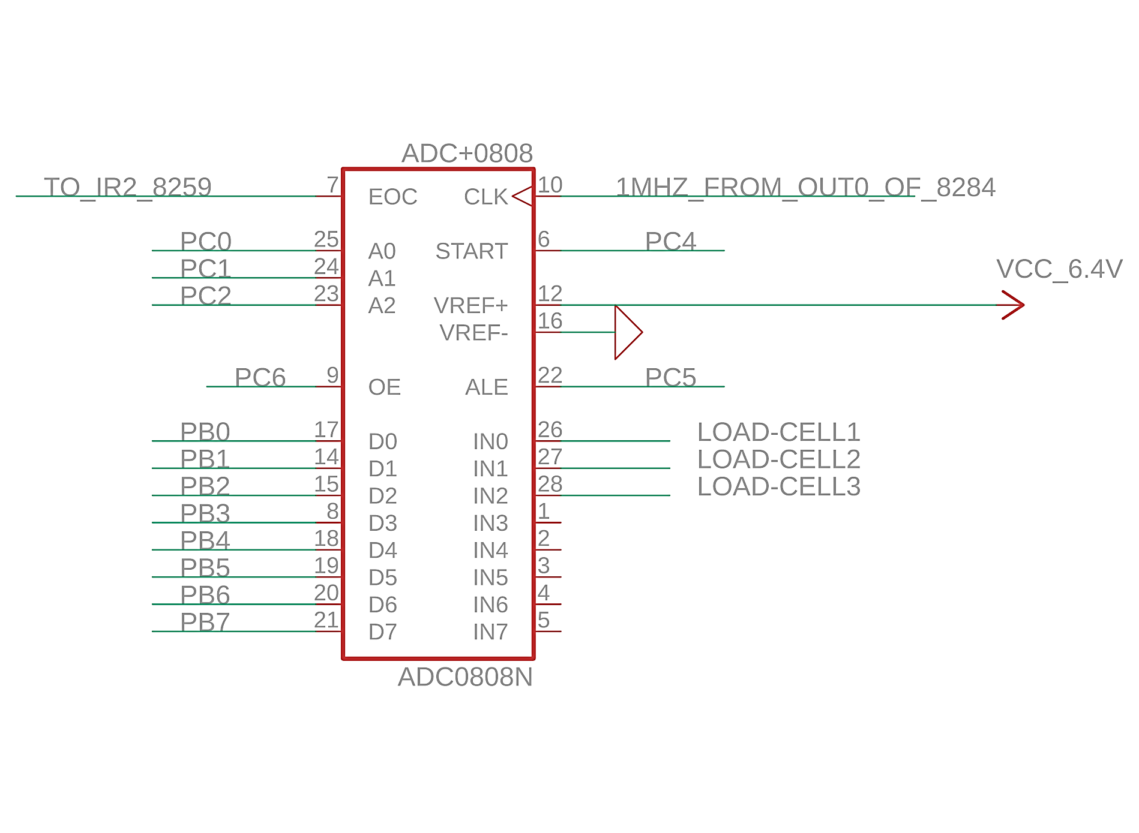
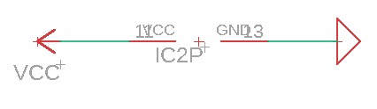
ADC 0808 - Analog-Digital Convertor
Vout (given in Problem Statement)
for Load Cell = 0.025 x weight(kg)
Therefore resolution is 0.025V
(25mV)
Now,
X / 256 = 0.025
X = 6.4 V
Where X is Vref+ to be found out
Since we are using 8-bit ADC, 2^8(256)
mappings are possible

Slide 20
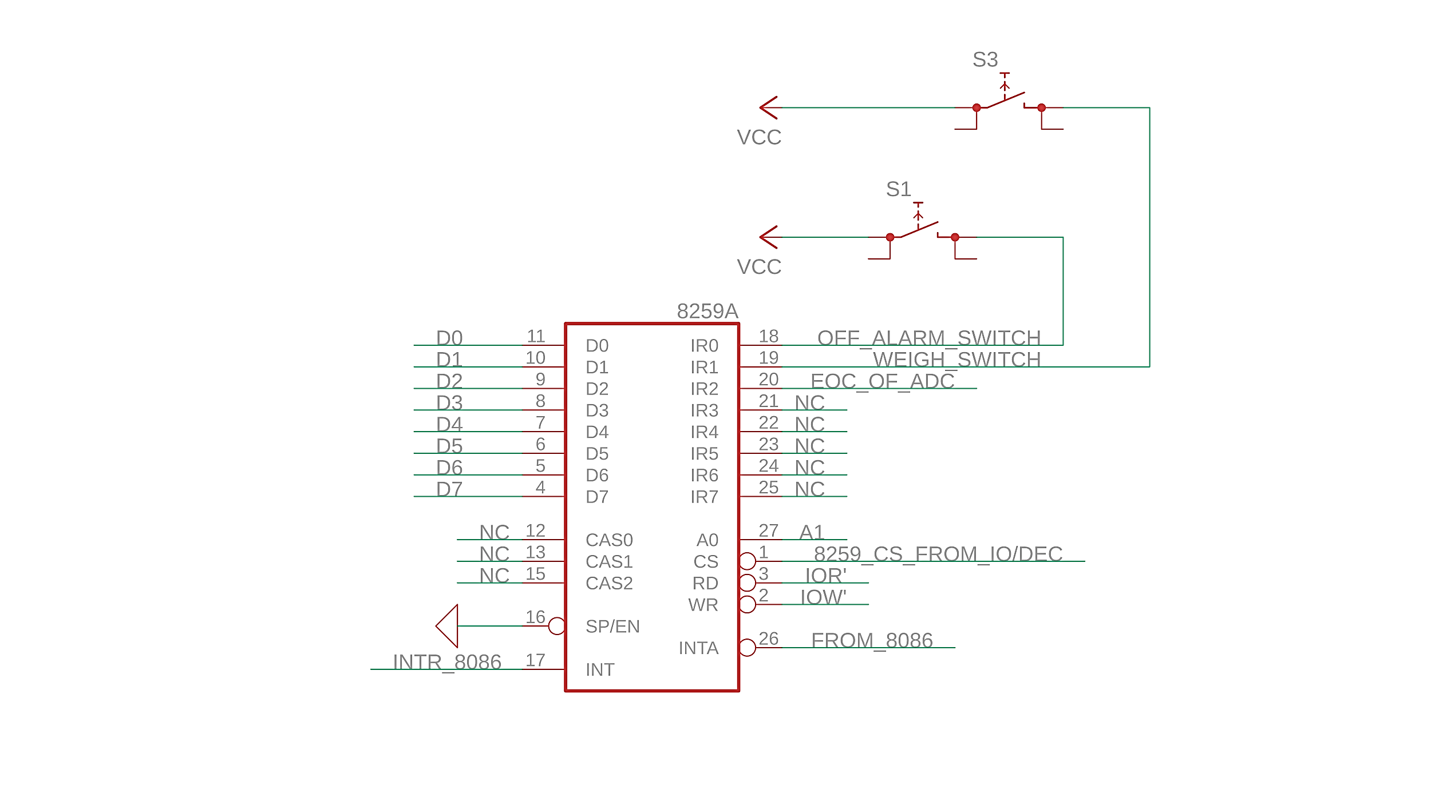
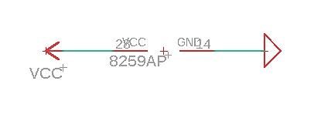
8259 - Interrupt Controller
INTA’

Slide 21
END OF FILE

